Slide 1
Battle of Neighbourhoods
By: Preshita Jaiswal

Slide 2
Introduction
The main aim of this project is to ease peoples choice making of a neighborhood in Etobicoke York, Toronto.
It will help in finding Cafe, School, Colleges, Grocery Shops, Theatre, Hospital etc.
This Project aim to create an analysis of features for a people migrating to Etobicoke York to search a best neighborhood as a comparative analysis between neighborhoods.
It will help people to get awareness of the area and neighborhood before moving to a city.

Slide 3
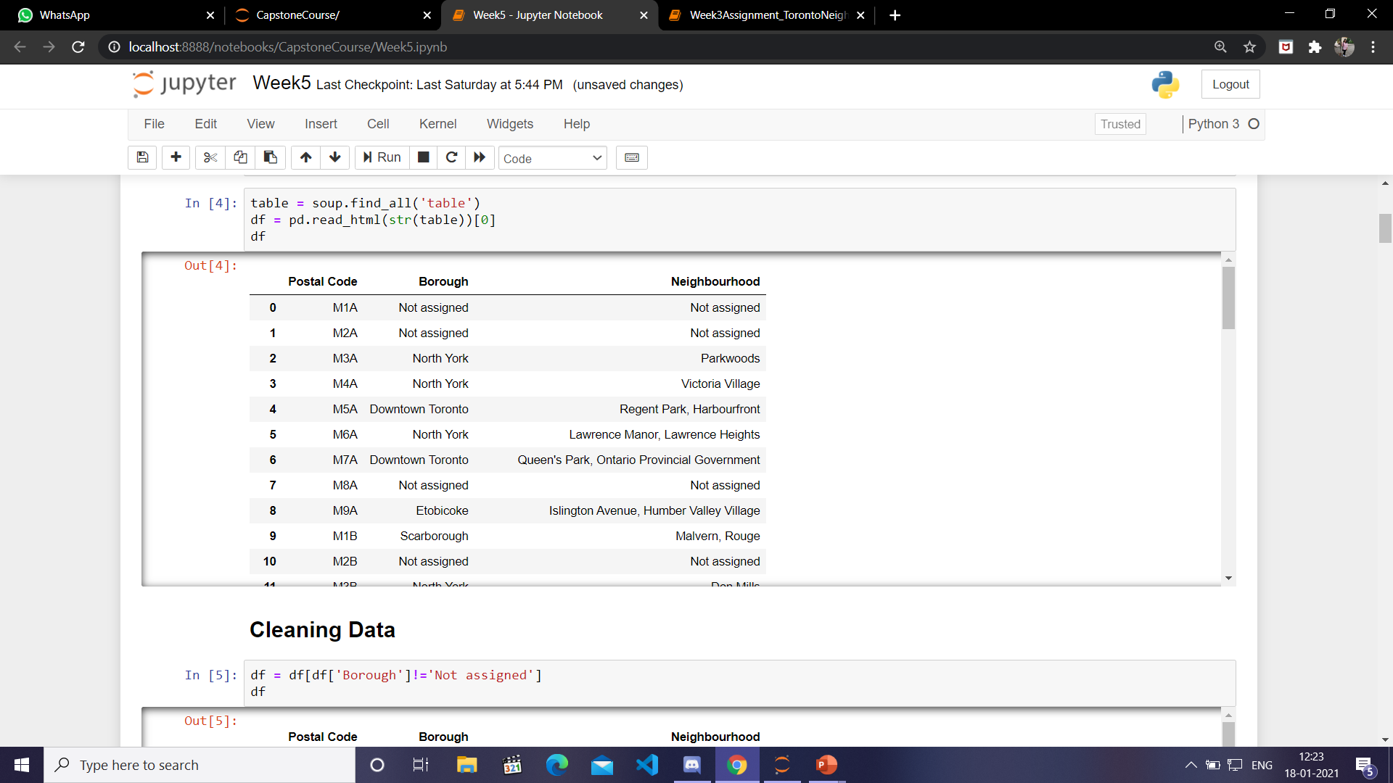
Data Description
Data Link: https://en.wikipedia.org/wiki/List_of_postal_codes_of_Canada:_M
Scraping this data will give us Postal Code, Borough, Neighbourhood of Toronto.

Slide 4
Libraries Used
Pandas: For creating and manipulating dataframes.
Folium: Python visualization library would be used to visualize the neighborhoods cluster distribution of using interactive leaflet map.
Scikit Learn: For importing k-means clustering.
JSON: Library to handle JSON files.
XML: To separate data from presentation and XML stores data in plain text format.
Geocoder: To retrieve Location Data.
Beautiful Soup and Requests: To scrap and library to handle http requests.
Matplotlib: Python Plotting Module.

Slide 5
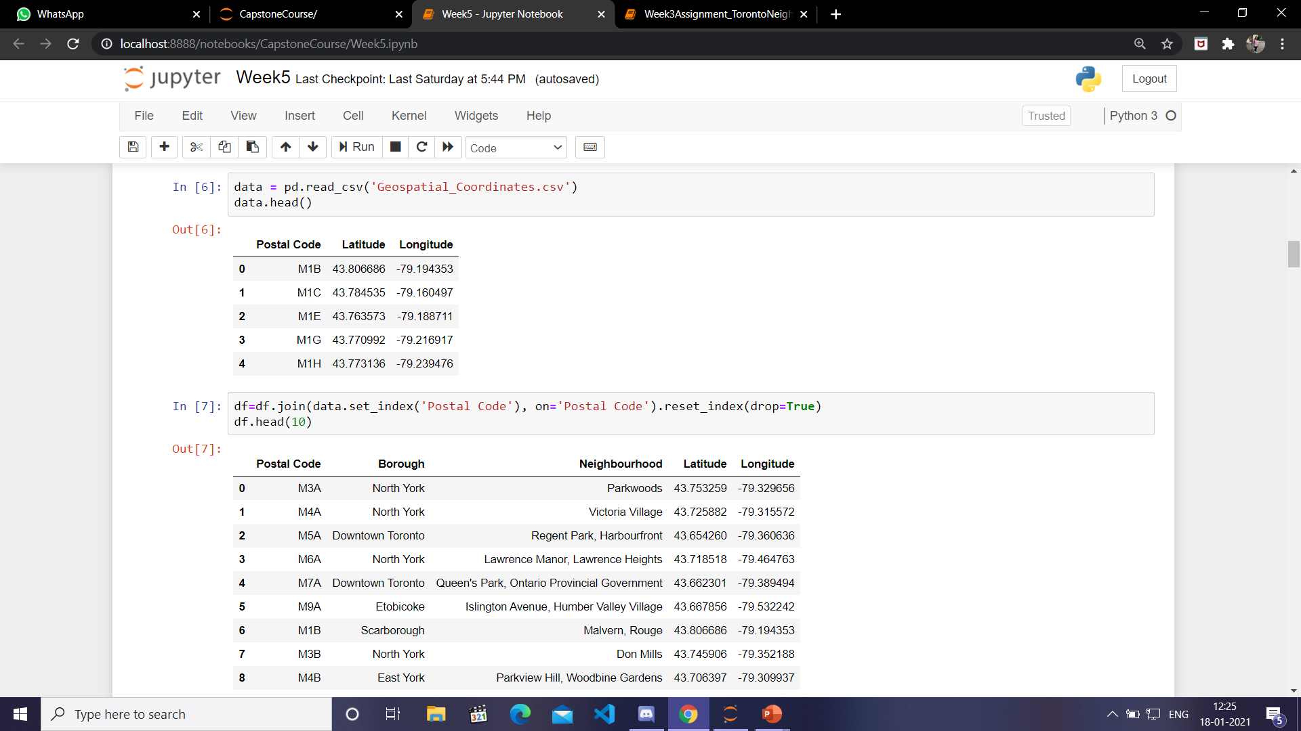
Finding Coordinates
Then I used Geospatial_Coordinates.csv to find the coordinates of neighbourhoods and merged that dataset with neighbourhood dataset.

Slide 6
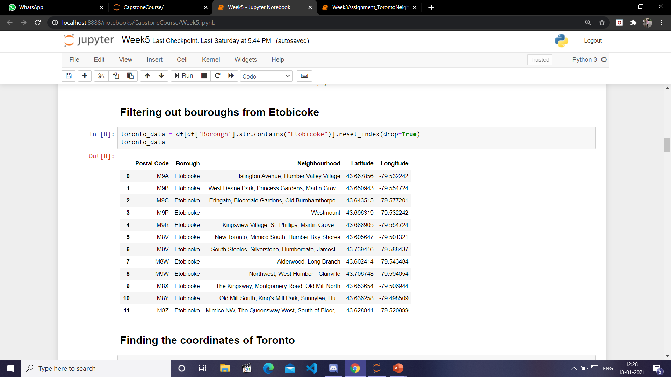
Extracting neighbourhoods of Etobicoke

Slide 7
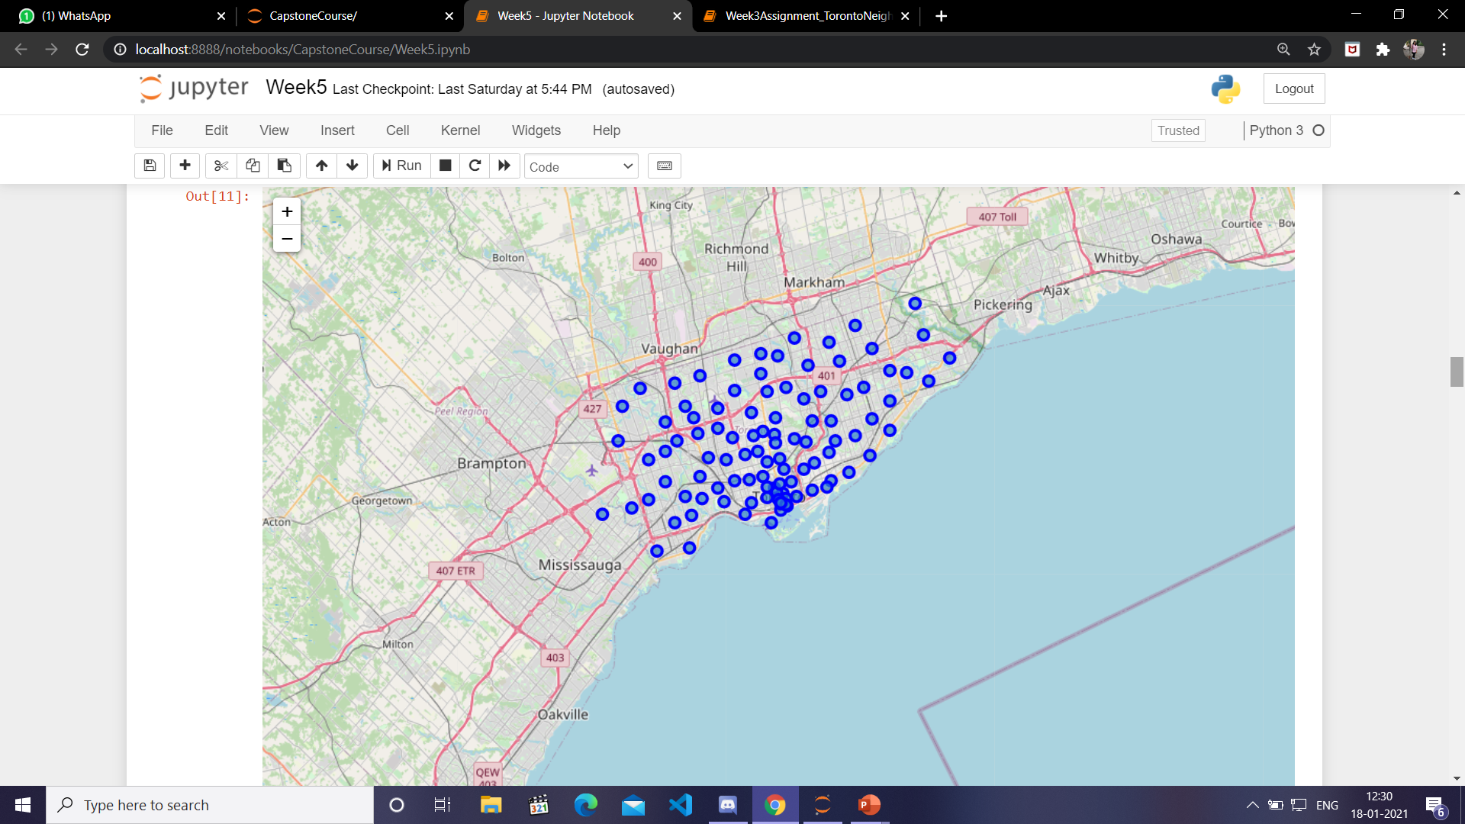
Finding Coordinates of Toronto and creating map

Slide 8
Next:
After that I first defined the credentials of Forsquare account.
Then I chose the 2nd neighbourhood in dataset and found out its credentials.
After that I found out the top 100 venues within a radius of 500 m of that neighbourhood.
I used Forsquare to do this. Then I converted the json data into a dataframe.
Then I created a dataset with features: Neighbourhood Name, Neighbourhood latitude, Neighbourhood longitude, Venue name, Venue latitude, Venue longitude and Venue Category.
Then I used one hot encoding on the above dataset.
Then I printed the neighbourhood name along with its top 5 common venues.

Slide 9
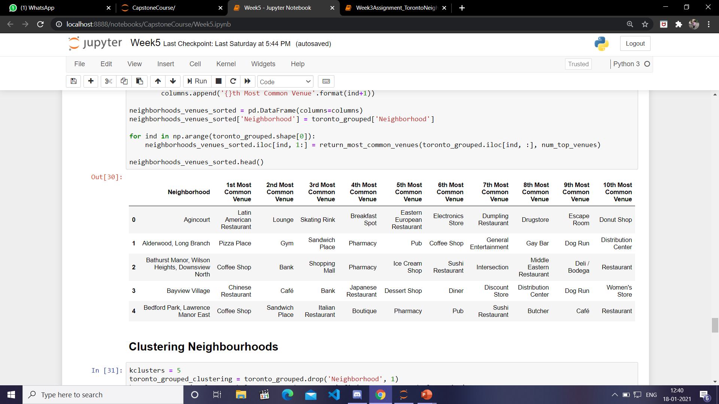
Finding common venues
Then I made a dataset consisting of neighbourhoods along with it top 10 common venues.

Slide 10
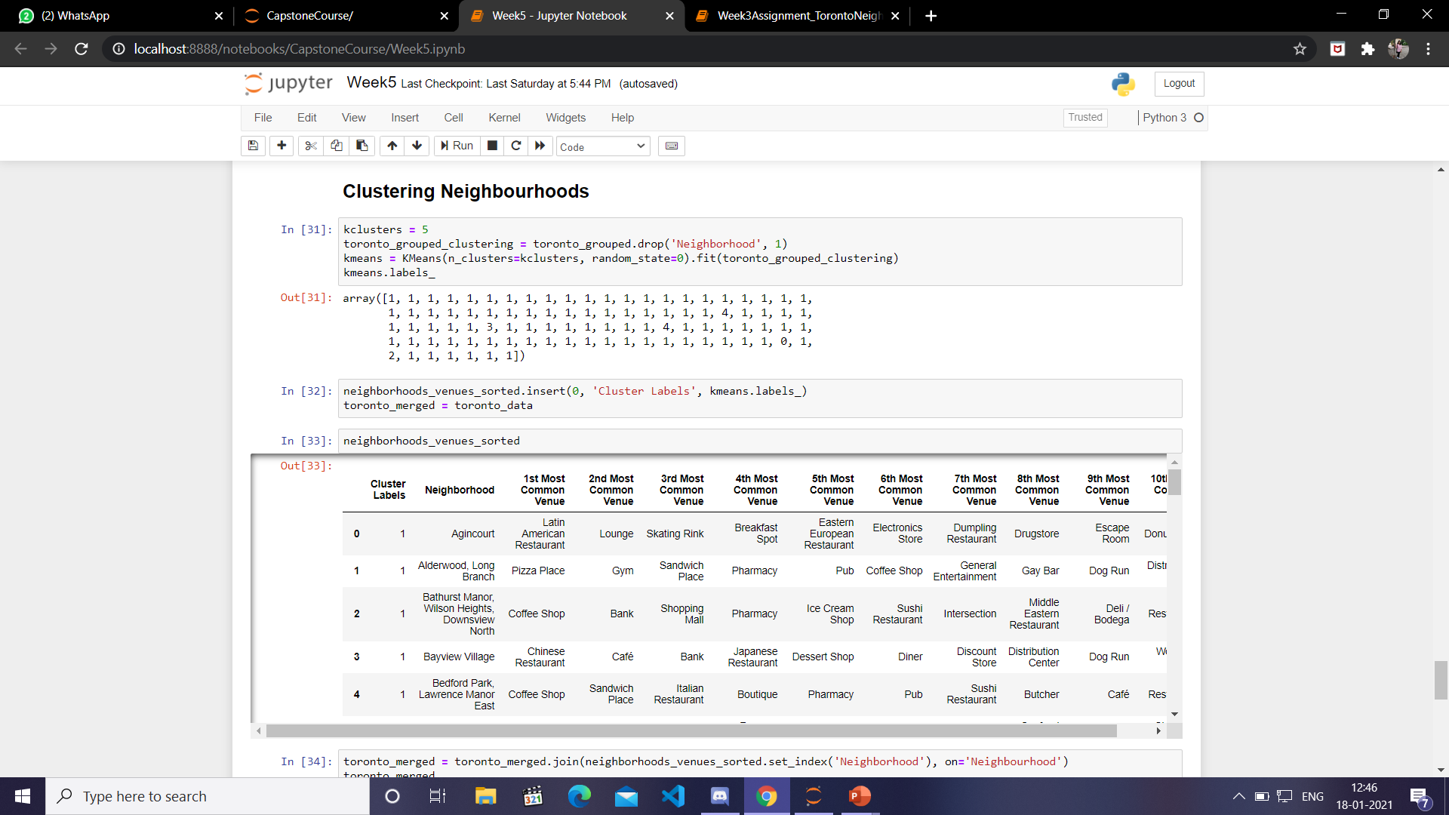
Clustering Dataset
Then I used K-means clustering method. I clustered the dataset in 5 clusters.

Slide 11
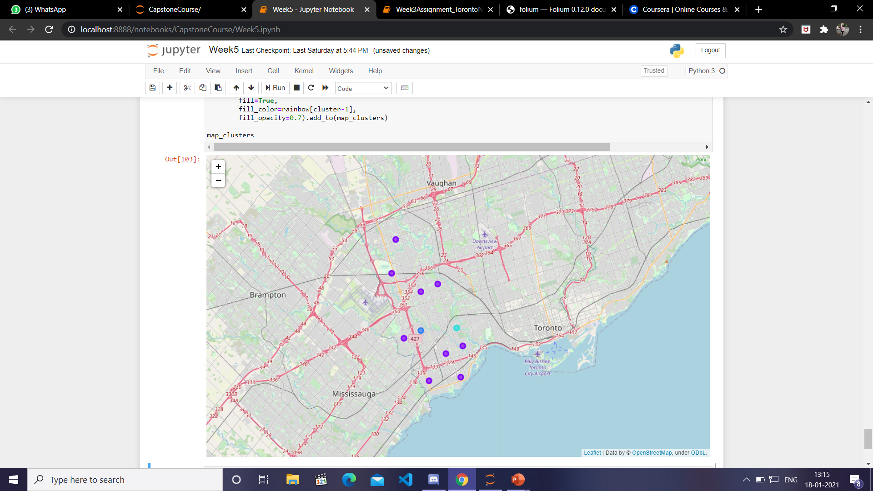
Result

Slide 12
Conclusion
This project help us to find the best, similar and nearby venues in Toronto. With the use of different libraries I was able to cluster the dataset into proper clusters.

